Slide 1


Deploying ML models
to production
with TensorFlow Serving
Riga Data Science Club
www.rigadsclub.com

Slide 2





Recap: TensorFlow deployment options
 | Pros | Cons
Client-side TensorFlow Lite | No network latency Works offline No server costs Privacy considerations (GDPR) | Loading time of a big model Device battery consumption Device storage limitations Limited TF2.0 features supported
Serverless Google Cloud Functions AWS Lambda | Relatively simple devops Great scalability Pay for run | Response time due cold start Function timeout limits Function memory limits Deployment package limits Invocation payload limits
Server-based Custom server (e.g. Flask) TensorFlow Serving | Great response time Scalable infrastructure Model versioning Scalable cost structure | Infrastructure management Server codebase management Idle server costs
Google Cloud AI Platform
Riga Data Science Club
www.rigadsclub.com
Notes:
Discuss, ask for questions/experience if any

Slide 3





Slide 4
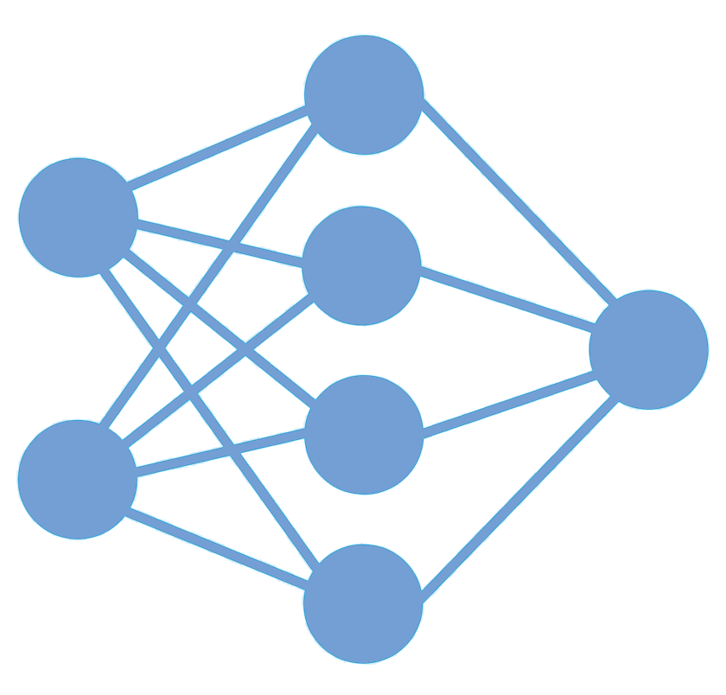

What is TensorFlow Serving?
Riga Data Science Club
www.rigadsclub.com
Notes:
TensorFlow Serving is a flexible, high-performance serving system for machine learning models, designed for production environments. TensorFlow Serving makes it easy to deploy new algorithms and experiments, while keeping the same server architecture and APIs. TensorFlow Serving provides out-of-the-box integration with TensorFlow models, but can be easily extended to serve other types of models and data.

Slide 5
Model status
GET http://host:port/v1/models/${MODEL_NAME}
GET http://api.rigadsclub.com/v1/models/riga
Request | Response
 | { "model_version_status": [ { "version": "123", "state": "AVAILABLE", "status": { "error_code": "OK", "error_message": "" } } ] }
Riga Data Science Club
www.rigadsclub.com
Notes:
TensorFlow Serving is a flexible, high-performance serving system for machine learning models, designed for production environments. TensorFlow Serving makes it easy to deploy new algorithms and experiments, while keeping the same server architecture and APIs. TensorFlow Serving provides out-of-the-box integration with TensorFlow models, but can be easily extended to serve other types of models and data.

Slide 6
Model metadata
GET http://host:port/v1/models/${MODEL_NAME}/metadata
GET http://api.rigadsclub.com/v1/models/riga/metadata
Request | Response
 | ... "area": { "dtype": "DT_FLOAT", "tensor_shape": {"dim": [ {"size": "-1","name": ""}, {"size": "1","name": ""} ]}, ...
Riga Data Science Club
www.rigadsclub.com
Notes:
TensorFlow Serving is a flexible, high-performance serving system for machine learning models, designed for production environments. TensorFlow Serving makes it easy to deploy new algorithms and experiments, while keeping the same server architecture and APIs. TensorFlow Serving provides out-of-the-box integration with TensorFlow models, but can be easily extended to serve other types of models and data.

Slide 7
Data types
TensorFlow | JSON | Example
DT_BOOL | true, false | true, false
DT_STRING | string | “Hello, World!”
DT_INT8, DT_UINT8, DT_INT16, DT_INT32, DT_UINT32, DT_INT64, DT_UINT64 | number | 42
DT_FLOAT, DT_DOUBLE | number | 3.14
Riga Data Science Club
www.rigadsclub.com
Notes:
g. If you have input feature or tensor values that need to be binary (like image bytes), you must Base64 encode the data and encapsulate it in a JSON object having b64 as the key as follows:
{ "b64": <base64 encoded string> }
You can specify this object as a value for an input feature or tensor. The same format is used to encode output response as well.

Slide 8

Data types
{ "b64": <base64 encoded string> }
Riga Data Science Club
www.rigadsclub.com
Notes:
g. If you have input feature or tensor values that need to be binary (like image bytes), you must Base64 encode the data and encapsulate it in a JSON object having b64 as the key as follows:
{ "b64": <base64 encoded string> }
You can specify this object as a value for an input feature or tensor. The same format is used to encode output response as well.

Slide 9
Predict
POST http://host:port/v1/models/${MODEL_NAME}:predict
POST http://api.rigadsclub.com/v1/models/riga:predict
Request | Response
{ "instances": [ { "op_type": ["For sale"], "district": ["Purvciems"], "street": [""], "rooms": [2], "area": [50], "floor": [5], "total_floors": [9], "house_seria": ["119."], "house_type": ["Panel"], "condition": ["All, amenities"], "lat": [56.948981770043346], "lon": [24.1429903312134] } ] } | { "predictions": [ [49611.4], ], }
Riga Data Science Club
www.rigadsclub.com

Slide 10

Time for getting hands dirty!

Slide 11

TensorFlow Serving with Docker
git clone git@github.com:rigadsclub/rigadslub-meetup-5-tensorflow-serving.git
cd rigadslub-meetup-5-tensorflow-serving
1. Run TensorFlow serving docker image:
docker run -d --name serving_base tensorflow/serving
2. Create own version of serving docker image:
docker cp saved_model_riga serving_base:/models/rre
docker commit --change "ENV MODEL_NAME rre" serving_base $USER/rre_serving
3. Perform cleanup:
docker kill serving_base
docker rm serving_base
Riga Data Science Club
www.rigadsclub.com

Slide 12
TensorFlow Serving with Docker
4. Run model locally
docker run -p 8500:8500 -t $USER/rre_serving &
5. Consume REST API
curl -X GET http://localhost:8501/v1/models/rre
curl -X GET http://localhost:8501/v1/models/rre/metadata
curl -X POST -H "Content-Type: application/json" -d @./sample_request.json http://localhost:8501/v1/models/rre:predict
Riga Data Science Club
www.rigadsclub.com

Slide 13
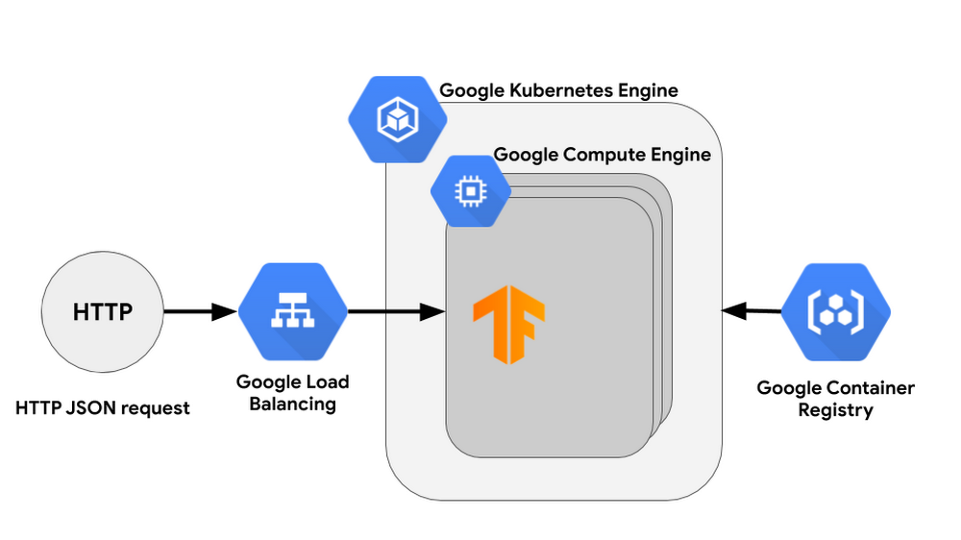
TensorFlow Serving in production
Riga Data Science Club
www.rigadsclub.com

Slide 14
Deploy to Kubernetes with Google Cloud
gcloud auth login --project rigadsclub-demo
gcloud container clusters create demo-cluster --num-nodes 1 --zone=europe-west1-b
gcloud config set container/cluster demo-cluster
gcloud container clusters get-credentials demo-cluster
docker tag $USER/rre_serving eu.gcr.io/rigadsclub-demo/rre
gcloud auth configure-docker
docker push eu.gcr.io/rigadsclub-demo/rre
Create a cluster:
Set the default cluster for gcloud container command and pass cluster credentials to kubectl:
Tag the image using the Container Registry format and our project name:
Configure Docker to use gcloud as a credential helper:
Push the image to the Registry:
Riga Data Science Club
www.rigadsclub.com

Slide 15
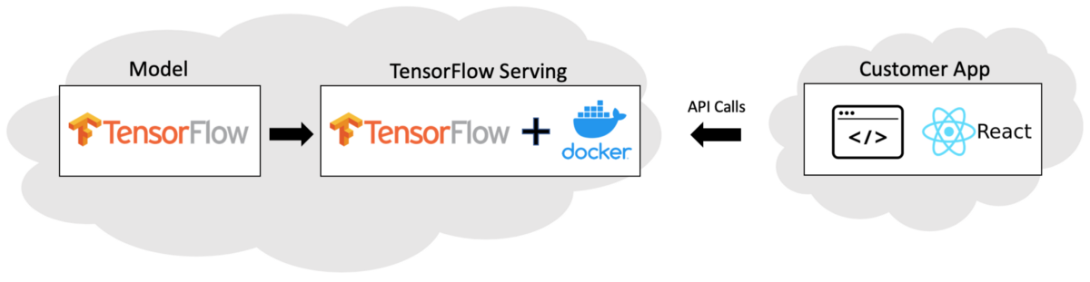
TensorFlow Serving in production
Riga Data Science Club
www.rigadsclub.com

Slide 16

Thank you!
Riga Data Science Club
www.rigadsclub.com

